Slide 1
Red5-AHU
One chart to keep buildings comfortable, healthy, and energy-smart
A plain-language look at how a smart air-handler tool meets every major ASHRAE standard — and why every Building Management System needs it.
Edge-native
No cloud
BACnet-native
ASHRAE-aligned

Slide 2
THE CHALLENGE
Three things every building must do — at once
Feel comfortable
Stay healthy
Save energy
Not too hot, not too cold, not too humid.
Enough fresh outside air so the air is safe to breathe.
Do both of the above without wasting power or money.
The catch
These goals fight each other. More comfort and more fresh air usually cost more energy. Getting all three right, all day, in every season — is hard.

Slide 3
THE RULEBOOKS
Four ASHRAE standards, in one line each
ASHRAE 55
Comfort
Will people feel comfortable?
ASHRAE 62.1
Fresh air
Is there enough outside air to stay healthy?
ASHRAE 90.1
Energy
Are we doing it without wasting energy?
Guideline 36
The referee
How do we run the equipment to hit all three?

Slide 4
THE BIG IDEA
One picture where all four rulebooks meet
Why it works
COMFORT
ASHRAE 55
FRESH AIR
ASHRAE 62.1
All four standards live on the SAME chart — temperature across the bottom, humidity up the side.
Plot one dot for the air and you can instantly see comfort, fresh-air mix, and energy — all together.
Psychrometric
Chart
Guideline 36 is the referee — the control logic that keeps the dot in the sweet spot automatically.
ENERGY · ASHRAE 90.1

Slide 5
HOW IT SATISFIES EACH
One dot on the chart answers every question
55 — Comfort
62.1 — Fresh air
The comfort zone is drawn on the chart. Is the dot inside the good T/humidity band? If not, which way is it off?
The mixed-air dot sits on the line between return and outside air — its position shows the fresh-air share at a glance.
90.1 — Energy
G36 — Sequences
Enthalpy lines reveal free cooling: when outside air is cooler, the economizer meets the load with no mechanical cooling.
Visual proof the automatic sequences land the dot in the comfort zone, on the fresh-air line, at the lowest energy path.
In one sentence: plot where the air IS, see where it MUST be, how it gets there, and whether it does so at minimum energy.

Slide 6
THE DIFFERENCE
Red5-AHU vs a traditional BMS
Supply-air energy (lower is better)
Traditional BMS
Red5-AHU
Fixed setpoint
100
Where it runs
Cloud / head-end PC
On the controller (edge)
Red5-AHU (B1–B10)
28
Standards built in
Add-on / manual
ASHRAE 55 · 62.1 · 90.1 · G36
≈ 70–75% less supply-air energy than a fixed year-round setpoint (internal estimate, temperate climate).
Diagnose an AHU
Dig through trends
One glance at the chart
Vendor lock-in
Usually yes
Open — MQTT/Modbus/BACnet
Languages
Often one
Five

Slide 7
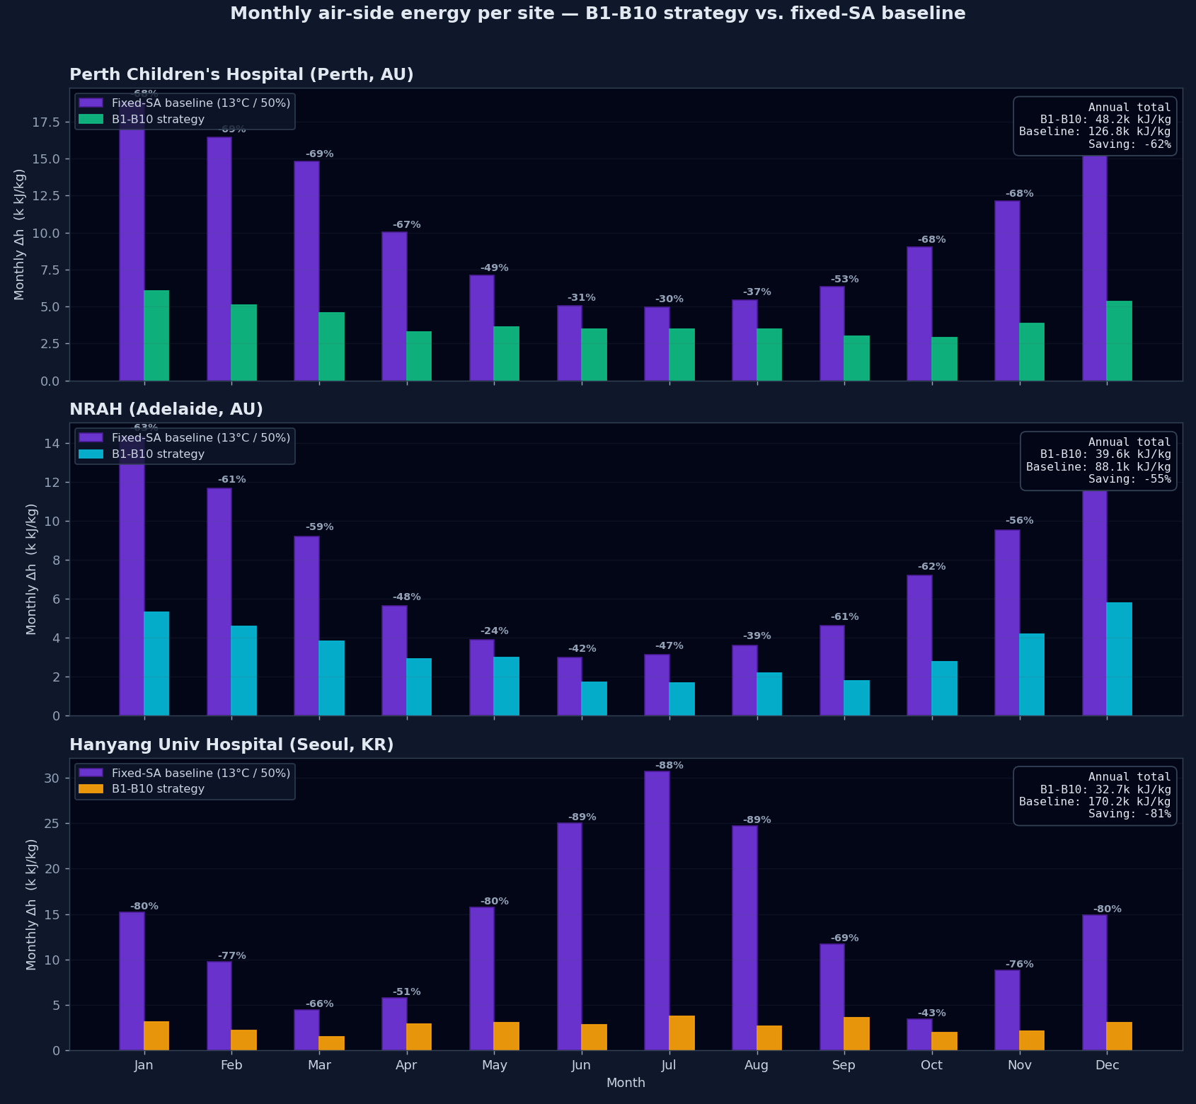
SEEING IT IN ACTION
The control follows the seasons
What you're looking at
Instead of one fixed target all year, Red5-AHU sets the supply-air target to match the season (climate bands B1–B10).
In mild months it leans on free outside-air cooling; in harsh months it does only as much conditioning as needed.
The result: month after month the air handler uses far less energy than a fixed setpoint — automatically, with no operator effort.

Slide 8
THE BOTTOM LINE
Why it's an essential BMS tool
Sees everything at once
Saves real energy
Runs on the controller
Comfort, fresh air, and energy on one live picture — no guesswork, no digging through data.
Automatic free-cooling and climate-adaptive supply air cut supply-air energy ~70%.
No cloud, no extra server. Fewer parts to fail, keeps working if the network drops.
Speaks BMS natively
Meets the standards
Easy to roll out
BACnet-native and open (MQTT/Modbus) — no vendor lock-in, integrates with what you have.
Aligned to ASHRAE 55 / 62.1 / 90.1 and Guideline 36 out of the box.
Diagnose at a glance, clone the setup to the next unit, in five languages.

Slide 9
Four rulebooks. One chart. Zero cloud.
Red5-AHU turns every air handler into a self-diagnosing, self-optimizing asset that satisfies ASHRAE 55, 62.1, 90.1 and Guideline 36 — right on the controller.

